Slide 1

Hybrid-multi Cloud with Nutanix Clusters

Slide 2
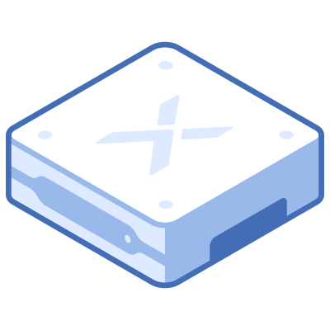
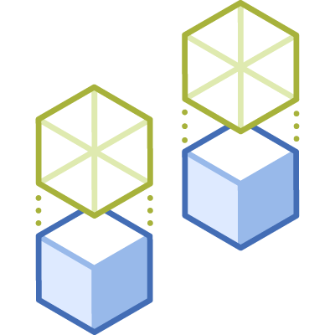
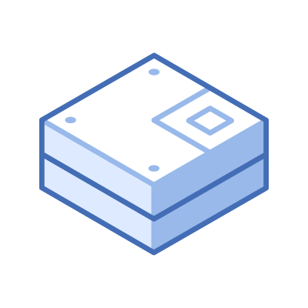
Hyperconverging Infrastructure
App
App
App
App
Virtualization
Virtualization
Server
Server
Storage Controller
Storage Controller
Storage Controller
Storage Controller
Storage Controller
Storage Controller
Integrated, scale-out compute and storage
with built-in virtualization
and management

Slide 3



Our Three Guiding Principles
1. Easy
One-click upgrades
One pane of glass
2. Intelligent
Intelligent automation and operations to remove complexities
3. Resilient
Self healing and resilient infrastructure, security, network

Slide 4


Who is Nutanix?
Nutanix Vision
Multi-Cloud Services
  Unify operations across public and private clouds
  Make Cloud Invisible
  Secure and automate applications, and consolidate storage
Build a Private Cloud
  Make Data Centers Invisible
Modernize IT with HCI
  Deliver enterprise apps and VDI from any site
  Make Infrastructure Invisible

Slide 5

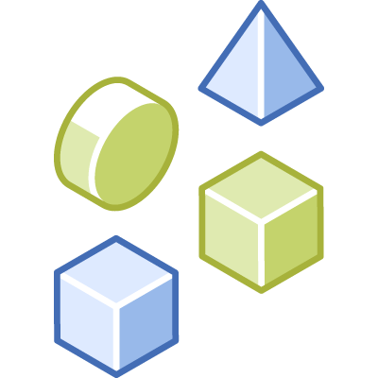
MORE SERVICES
NO IT GOVERNANCE
Private clouds
ENTERPRISE IT
Legacy
FEWER SERVICES
Notes:
On demand

Slide 6





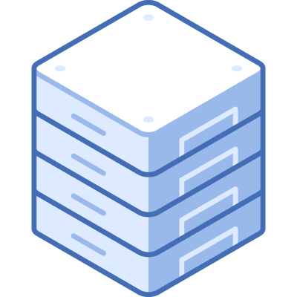
Hybrid Cloud Complexity
Integration
SaaS App
Private Cloud
Cross-cloud Security
Data Locality
Public
Hybrid
Data Center
Hosted Private
License Portability
Visibility
Traditional Hosting
Workload Portability
Latency and
Direct Connect

Slide 7

What Customers Want
License portability, no cloud lock in
Native integration into cloud accounts
Seamless movement and elasticity between clouds
Single platform using consistent constructs and skillsets
Cloud Platform
HYBRID-MULTI CLOUD
Notes:
There is a strong need for a single operating system that can span private, distributed and public clouds so that operators can manage their traditional and modern applications using a single platform. Such platform must seamlessly extend between clouds, allowing administrators to move VMs and applications without translation and without learning new practices or tooling. For true cloud optionality, there’s a need for a solution that provides license portability, empowering operators to choose the best cloud for each application.

Slide 8
USE CASES
I/O Intensive Apps
VDI on Cloud
Business Continuity
Tackle high end databases, big data and other I/O intensive apps
Start small and scale to support thousands of end-users with excellent user experience
Use the Cloud for high availability and disaster recovery
Lift and Shift
On Demand Elasticity
Cloud Native Services
Modernize applications and connect natively to cloud services
Consolidate datacenters and move applications to the cloud
Extend in minutes to handle bursts or seasonal demands and rapidly create Dev/Test

Slide 9
Use Case 1 – True On-demand Elasticity
True on-demand elasticity with ability to burst workloads to the cloud
Geographical expansion to be closer to users without your own physical Data centers and capex investments
Scale up or scale down due to seasonal or temporary demands
Expand Dev/Test/Prod to cloud
Elasticity
Hybrid-Multi Cloud Platform
Notes:
Private to Public Extension
Operate your applications and infrastructure in AWS as you do with on-premises infrastructure. Using the same platform on both clouds, dramatically reduce the operational complexity of extending, busting or migrating your applications and data between clouds.
Same VMs and applications work in AWS without retooling
Hybrid elasticity – burst additional capacity and hibernate/resume as needed
Consistent Skillset for any Cloud
Manage your applications with nearly identical experience across clouds - utilizing the same operational practices, third-party integrations and troubleshooting procedures that you’ve developed over many years. Eliminate retooling or training needed to operate your apps in public cloud environments.
Seamless Integration with Public Cloud
Xi Clusters integrates into public cloud accounts like AWS, so that you can run applications within existing VPCs, eliminating network complexity and improving performance. Hybrid should not create a new silo.
Utilize corporate AWS credits
Eliminate the need for separate VPC or VPN for Hybrid Cloud deployment
Direct access to AWS cloud services without network translations
Seamlessly utilize existing AWS accounts, not new silo for hybrid
Software Portability
Maintain cloud optionality with portable software that can move with your applications and data across clouds. With a common consumption model that spans private and public, you can confidently plan your long term hybrid and multi cloud strategy, maximizing the benefits of each environment.
Cloud Services (SaaS)
Standardize operations across private and public environments with a set of offerings that
Orchestration & Self-Service – cloud orchestration that automates provisioning and lifecycle of any application. Empower end-users with one-click self-service for deployment or management of applications in public and/or private clouds.
Cost Optimization - Get visibility into your cloud consumption patterns across both public and private clouds. Identify idle and under-utilized resources and get reserved instance recommendations for deep cost savings.
Security compliance - Identify and fix security issues in real-time. Automate compliance checks for cloud operations using 250+ audits. Get compliance checks for regulatory policies such as HIPAA, PCI-DSS, NIST, and more.
Desktop-as-a-Service (DaaS) - Scale globally in the cloud with AWS, Microsoft Azure, Google Cloud Platform, and other partners. Or deploy on-premises with Nutanix
Disaster Recovery as a Service (DRaaS) - integrated cloud disaster recovery service that eliminates the need for provisioning, configuring, and managing disparate cloud environments or multiple solutions for DR protection

Slide 10
Use Case 2 – Lift and Shift with Seamless Mobility
Move applications and virtual machines to cloud without re-architecture or re-factoring
Consolidate DC into public AZs
Move I/O Intensive apps to leverage AOS performance on top of AWS bare metal
Move glacial data to cloud while still maintaining control
Lift and Shift
Elasticity
Hybrid-Multi Cloud Platform
Notes:
Private to Public Extension
Operate your applications and infrastructure in AWS as you do with on-premises infrastructure. Using the same platform on both clouds, dramatically reduce the operational complexity of extending, busting or migrating your applications and data between clouds.
Same VMs and applications work in AWS without retooling
Hybrid elasticity – burst additional capacity and hibernate/resume as needed
Consistent Skillset for any Cloud
Manage your applications with nearly identical experience across clouds - utilizing the same operational practices, third-party integrations and troubleshooting procedures that you’ve developed over many years. Eliminate retooling or training needed to operate your apps in public cloud environments.
Seamless Integration with Public Cloud
Xi Clusters integrates into public cloud accounts like AWS, so that you can run applications within existing VPCs, eliminating network complexity and improving performance. Hybrid should not create a new silo.
Utilize corporate AWS credits
Eliminate the need for separate VPC or VPN for Hybrid Cloud deployment
Direct access to AWS cloud services without network translations
Seamlessly utilize existing AWS accounts, not new silo for hybrid
Software Portability
Maintain cloud optionality with portable software that can move with your applications and data across clouds. With a common consumption model that spans private and public, you can confidently plan your long term hybrid and multi cloud strategy, maximizing the benefits of each environment.
Cloud Services (SaaS)
Standardize operations across private and public environments with a set of offerings that
Orchestration & Self-Service – cloud orchestration that automates provisioning and lifecycle of any application. Empower end-users with one-click self-service for deployment or management of applications in public and/or private clouds.
Cost Optimization - Get visibility into your cloud consumption patterns across both public and private clouds. Identify idle and under-utilized resources and get reserved instance recommendations for deep cost savings.
Security compliance - Identify and fix security issues in real-time. Automate compliance checks for cloud operations using 250+ audits. Get compliance checks for regulatory policies such as HIPAA, PCI-DSS, NIST, and more.
Desktop-as-a-Service (DaaS) - Scale globally in the cloud with AWS, Microsoft Azure, Google Cloud Platform, and other partners. Or deploy on-premises with Nutanix
Disaster Recovery as a Service (DRaaS) - integrated cloud disaster recovery service that eliminates the need for provisioning, configuring, and managing disparate cloud environments or multiple solutions for DR protection

Slide 11
Use Case 3 –Cloud Native Integration
Launch clusters in your own cloud accounts and virtual networks
Use Cloud services with current on-prem applications
Add cloud-based AI/ML to existing applications
Cloud Native Integration
Lift and Shift
Elasticity
Hybrid-Multi Cloud Platform
Notes:
Private to Public Extension
Operate your applications and infrastructure in AWS as you do with on-premises infrastructure. Using the same platform on both clouds, dramatically reduce the operational complexity of extending, busting or migrating your applications and data between clouds.
Same VMs and applications work in AWS without retooling
Hybrid elasticity – burst additional capacity and hibernate/resume as needed
Consistent Skillset for any Cloud
Manage your applications with nearly identical experience across clouds - utilizing the same operational practices, third-party integrations and troubleshooting procedures that you’ve developed over many years. Eliminate retooling or training needed to operate your apps in public cloud environments.
Seamless Integration with Public Cloud
Xi Clusters integrates into public cloud accounts like AWS, so that you can run applications within existing VPCs, eliminating network complexity and improving performance. Hybrid should not create a new silo.
Utilize corporate AWS credits
Eliminate the need for separate VPC or VPN for Hybrid Cloud deployment
Direct access to AWS cloud services without network translations
Seamlessly utilize existing AWS accounts, not new silo for hybrid
Software Portability
Maintain cloud optionality with portable software that can move with your applications and data across clouds. With a common consumption model that spans private and public, you can confidently plan your long term hybrid and multi cloud strategy, maximizing the benefits of each environment.
Cloud Services (SaaS)
Standardize operations across private and public environments with a set of offerings that
Orchestration & Self-Service – cloud orchestration that automates provisioning and lifecycle of any application. Empower end-users with one-click self-service for deployment or management of applications in public and/or private clouds.
Cost Optimization - Get visibility into your cloud consumption patterns across both public and private clouds. Identify idle and under-utilized resources and get reserved instance recommendations for deep cost savings.
Security compliance - Identify and fix security issues in real-time. Automate compliance checks for cloud operations using 250+ audits. Get compliance checks for regulatory policies such as HIPAA, PCI-DSS, NIST, and more.
Desktop-as-a-Service (DaaS) - Scale globally in the cloud with AWS, Microsoft Azure, Google Cloud Platform, and other partners. Or deploy on-premises with Nutanix
Disaster Recovery as a Service (DRaaS) - integrated cloud disaster recovery service that eliminates the need for provisioning, configuring, and managing disparate cloud environments or multiple solutions for DR protection

Slide 12
Use Case 4 – Business Continuity and DR
Use Cloud as a target for replication and disaster recovery with no installation
Geographical policy based DRs
Choose what you want to protect
Reliability
Cloud-Native Integration
Lift and Shift
Elasticity
Hybrid-Multi Cloud Platform
Notes:
Private to Public Extension
Operate your applications and infrastructure in AWS as you do with on-premises infrastructure. Using the same platform on both clouds, dramatically reduce the operational complexity of extending, busting or migrating your applications and data between clouds.
Same VMs and applications work in AWS without retooling
Hybrid elasticity – burst additional capacity and hibernate/resume as needed
Consistent Skillset for any Cloud
Manage your applications with nearly identical experience across clouds - utilizing the same operational practices, third-party integrations and troubleshooting procedures that you’ve developed over many years. Eliminate retooling or training needed to operate your apps in public cloud environments.
Seamless Integration with Public Cloud
Xi Clusters integrates into public cloud accounts like AWS, so that you can run applications within existing VPCs, eliminating network complexity and improving performance. Hybrid should not create a new silo.
Utilize corporate AWS credits
Eliminate the need for separate VPC or VPN for Hybrid Cloud deployment
Direct access to AWS cloud services without network translations
Seamlessly utilize existing AWS accounts, not new silo for hybrid
Software Portability
Maintain cloud optionality with portable software that can move with your applications and data across clouds. With a common consumption model that spans private and public, you can confidently plan your long term hybrid and multi cloud strategy, maximizing the benefits of each environment.
Cloud Services (SaaS)
Standardize operations across private and public environments with a set of offerings that
Orchestration & Self-Service – cloud orchestration that automates provisioning and lifecycle of any application. Empower end-users with one-click self-service for deployment or management of applications in public and/or private clouds.
Cost Optimization - Get visibility into your cloud consumption patterns across both public and private clouds. Identify idle and under-utilized resources and get reserved instance recommendations for deep cost savings.
Security compliance - Identify and fix security issues in real-time. Automate compliance checks for cloud operations using 250+ audits. Get compliance checks for regulatory policies such as HIPAA, PCI-DSS, NIST, and more.
Desktop-as-a-Service (DaaS) - Scale globally in the cloud with AWS, Microsoft Azure, Google Cloud Platform, and other partners. Or deploy on-premises with Nutanix
Disaster Recovery as a Service (DRaaS) - integrated cloud disaster recovery service that eliminates the need for provisioning, configuring, and managing disparate cloud environments or multiple solutions for DR protection

Slide 13
Use Case 5 – Unified Management Plane and Cost Governance
Use a single management plane for all your infrastructure for utilization, security policies and cost
Discover and act on inefficiencies and cost over-runs
No Cloud Lock-in !!
Unified Management Plane
Reliability
Cloud Native Integration
Lift and Shift
Elasticity
Hybrid-Multi Cloud Platform
Notes:
Private to Public Extension
Operate your applications and infrastructure in AWS as you do with on-premises infrastructure. Using the same platform on both clouds, dramatically reduce the operational complexity of extending, busting or migrating your applications and data between clouds.
Same VMs and applications work in AWS without retooling
Hybrid elasticity – burst additional capacity and hibernate/resume as needed
Consistent Skillset for any Cloud
Manage your applications with nearly identical experience across clouds - utilizing the same operational practices, third-party integrations and troubleshooting procedures that you’ve developed over many years. Eliminate retooling or training needed to operate your apps in public cloud environments.
Seamless Integration with Public Cloud
Xi Clusters integrates into public cloud accounts like AWS, so that you can run applications within existing VPCs, eliminating network complexity and improving performance. Hybrid should not create a new silo.
Utilize corporate AWS credits
Eliminate the need for separate VPC or VPN for Hybrid Cloud deployment
Direct access to AWS cloud services without network translations
Seamlessly utilize existing AWS accounts, not new silo for hybrid
Software Portability
Maintain cloud optionality with portable software that can move with your applications and data across clouds. With a common consumption model that spans private and public, you can confidently plan your long term hybrid and multi cloud strategy, maximizing the benefits of each environment.
Cloud Services (SaaS)
Standardize operations across private and public environments with a set of offerings that
Orchestration & Self-Service – cloud orchestration that automates provisioning and lifecycle of any application. Empower end-users with one-click self-service for deployment or management of applications in public and/or private clouds.
Cost Optimization - Get visibility into your cloud consumption patterns across both public and private clouds. Identify idle and under-utilized resources and get reserved instance recommendations for deep cost savings.
Security compliance - Identify and fix security issues in real-time. Automate compliance checks for cloud operations using 250+ audits. Get compliance checks for regulatory policies such as HIPAA, PCI-DSS, NIST, and more.
Desktop-as-a-Service (DaaS) - Scale globally in the cloud with AWS, Microsoft Azure, Google Cloud Platform, and other partners. Or deploy on-premises with Nutanix
Disaster Recovery as a Service (DRaaS) - integrated cloud disaster recovery service that eliminates the need for provisioning, configuring, and managing disparate cloud environments or multiple solutions for DR protection

Slide 14
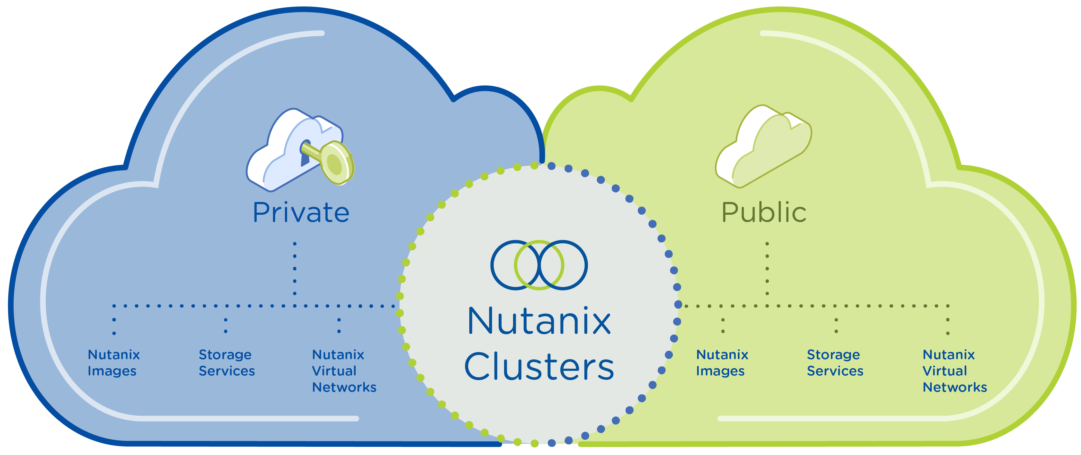
Nutanix Clusters
Nutanix Clusters delivers Nutanix platform running on AWS bare metal
Single Management plane with Prism
True Hybrid-Multi Cloud architecture but operated as a single cloud
Hybrid-Multi Cloud Platform
OPERATIONAL EFFICIENCY AND SIMPLICITY
Notes:
Nutanix Clusters is an upcoming offering that enables enterprises to run AOS clusters in Amazon Web Services (AWS). These Nutanix AOS clusters will run on bare metal EC2 instances and be managed via Prism Central, providing nearly identical functionality to on-premises AOS environments. Customers will be able to leverage their existing AWS accounts, credits, VPCs, VPNs and Direct Connect configurations. As a result, customers get a full Enterprise Cloud experience without having to deploy or manage datacenter infrastructure.

Slide 15

MORE SERVICES
NO IT GOVERNANCE
Private clouds
ENTERPRISE IT
Legacy
FEWER SERVICES
Notes:
On demand

Slide 16
Why Nutanix Clusters
1
Flexibility and Freedom of Choice
2
Operational Simplicity
3
Enabling Performance Intensive Workloads
4
Cost Efficiencies

Slide 17

OPERATING MODEL
INFRASTRUCTURE
LICENSE AND COST
FREEDOM OF CHOICE

Slide 18
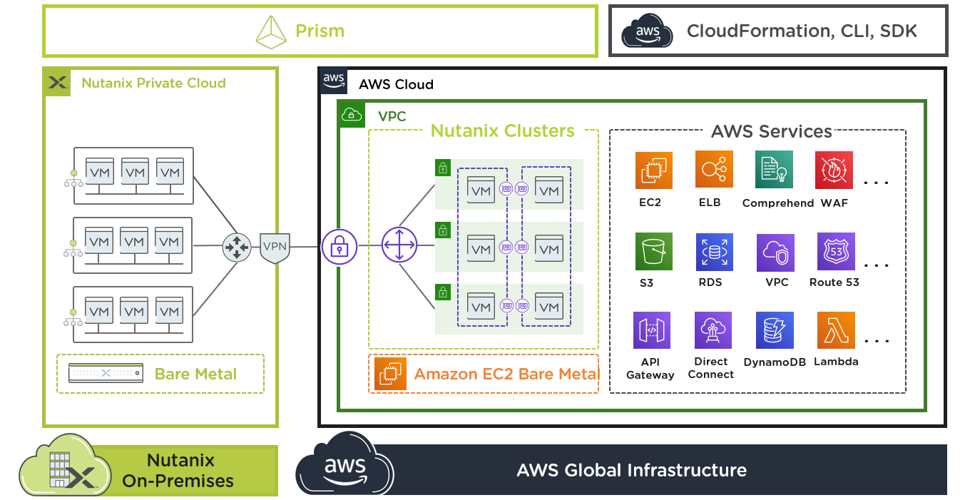
Operational Simplicity
3-click provisioning
Self service vs managed services
No middle layer between on-prem and AWS VPC enabling lower latency

Slide 19



Cost Effective State Preservation
Prism
Single click hibernate
Resume cluster and all VMs on-demand
No loss of data
Nutanix Enterprise Cloud Platform
Amazon EC2 Bare Metal Instances
Amazon Simple Storage Service (S3)
Nutanix Private Cloud
AWS
AWS

Slide 20
License Portability
Cloud Services
Orchestration and Self-Service
Cost
Optimization
Security Compliance
Desktop
as-a-Service
Disaster Recovery
as-a-Service
Software license portability across clouds
Native integration into public cloud accounts
Consistent skillset and operational practices
Private to public extension without retooling
Cloud Platform
Notes:
Private to Public Extension
Operate your applications and infrastructure in AWS as you do with on-premises infrastructure. Using the same platform on both clouds, dramatically reduce the operational complexity of extending, busting or migrating your applications and data between clouds.
Same VMs and applications work in AWS without retooling
Hybrid elasticity – burst additional capacity and hibernate/resume as needed
Consistent Skillset for any Cloud
Manage your applications with nearly identical experience across clouds - utilizing the same operational practices, third-party integrations and troubleshooting procedures that you’ve developed over many years. Eliminate retooling or training needed to operate your apps in public cloud environments.
Seamless Integration with Public Cloud
Xi Clusters integrates into public cloud accounts like AWS, so that you can run applications within existing VPCs, eliminating network complexity and improving performance. Hybrid should not create a new silo.
Utilize corporate AWS credits
Eliminate the need for separate VPC or VPN for Hybrid Cloud deployment
Direct access to AWS cloud services without network translations
Seamlessly utilize existing AWS accounts, not new silo for hybrid
Software Portability
Maintain cloud optionality with portable software that can move with your applications and data across clouds. With a common consumption model that spans private and public, you can confidently plan your long term hybrid and multi cloud strategy, maximizing the benefits of each environment.
Cloud Services (SaaS)
Standardize operations across private and public environments with a set of offerings that
Orchestration & Self-Service – cloud orchestration that automates provisioning and lifecycle of any application. Empower end-users with one-click self-service for deployment or management of applications in public and/or private clouds.
Cost Optimization - Get visibility into your cloud consumption patterns across both public and private clouds. Identify idle and under-utilized resources and get reserved instance recommendations for deep cost savings.
Security compliance - Identify and fix security issues in real-time. Automate compliance checks for cloud operations using 250+ audits. Get compliance checks for regulatory policies such as HIPAA, PCI-DSS, NIST, and more.
Desktop-as-a-Service (DaaS) - Scale globally in the cloud with AWS, Microsoft Azure, Google Cloud Platform, and other partners. Or deploy on-premises with Nutanix
Disaster Recovery as a Service (DRaaS) - integrated cloud disaster recovery service that eliminates the need for provisioning, configuring, and managing disparate cloud environments or multiple solutions for DR protection

Slide 21
Billing Model
Nutanix Software
Customer pays to Nutanix
Free Trial
Licenses
Cloud Commit
Try all Nutanix products for free for 30 days
Bring your own on premises Nutanix licenses
Term-based minimum
monthly commit
+
Cloud Infrastructure
Customer pays to the cloud provider
On Demand
Reserved
Convertible
No Contract
No/Partial/All Upfront
1 or 3 years
No/Partial/All Upfront
1 or 3 years

Slide 22
Billing Model
Licenses
Cloud Commit
Bring your own on premises Nutanix license
Term-based minimum
monthly commit
Hybrid
Consumption
Cloud
Consumption
License Mobility
Channel procurement
Choice of platform
(Any Cloud)
All SW products
(AOS (STR, PRO, ULT), Files, Flow, Prism, Calm, Karbon, Era, Objects)
Utility based consumption
Online, self serve procurement
Choice of payment frequency
(All upfront or monthly)
AOS (PRO, ULT), Files, Xi Beam, Flow, Calm

Slide 23
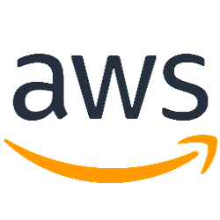
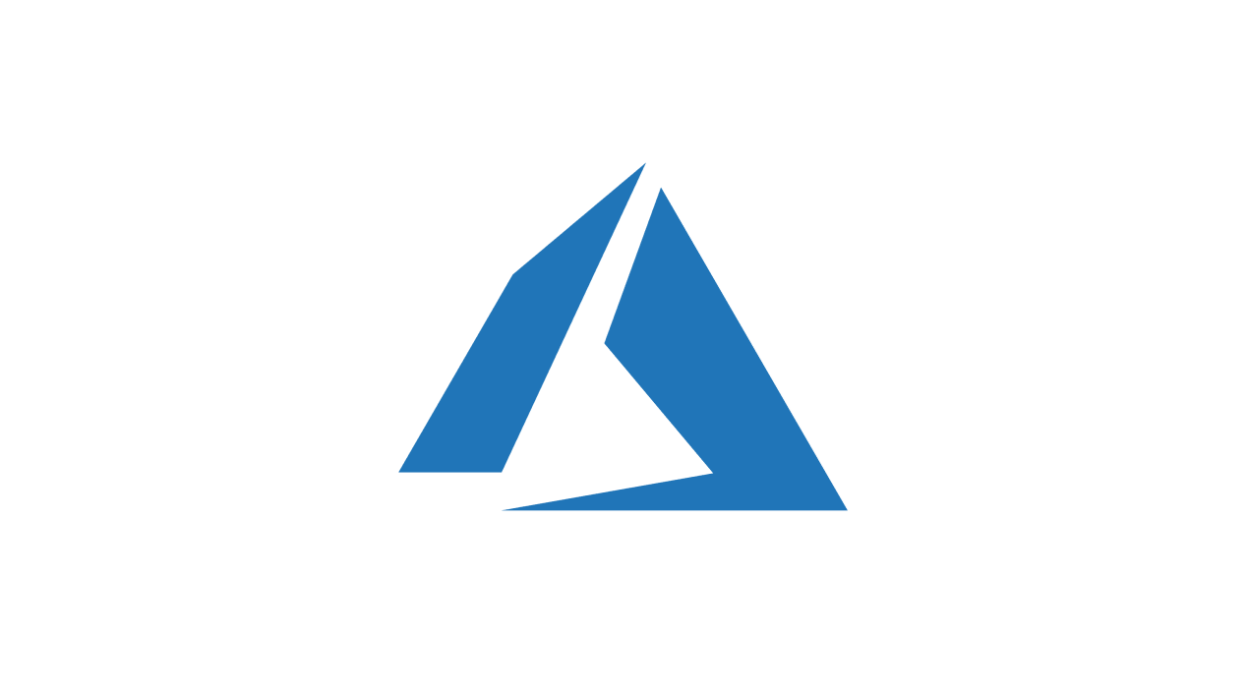
License Mobility
Cluster A
Cluster B
New Subscription
Existing Licenses
Cluster C

Slide 24
See to Believe
nutanix.com/test-drive

Slide 25
Thank You

Slide 26
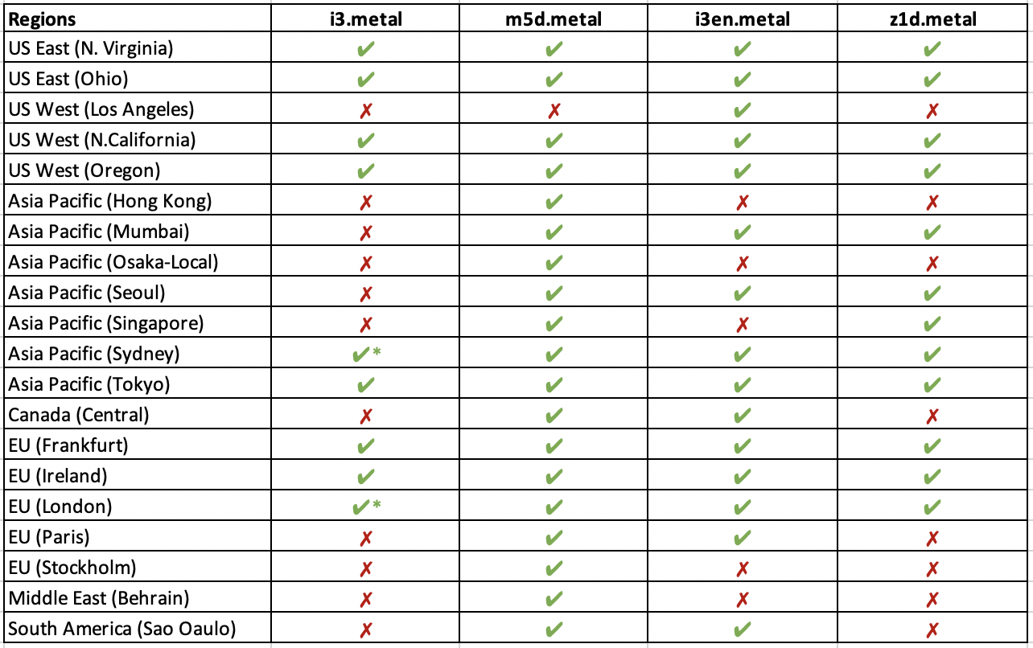
AWS Instances & Regions
Starting at
$2.11/hr
(3Y commit price)
Storage Optimized
36 cores
72 vCPUs
512 GB Memory
15.2 TB NVMe SSD
i3
General Purpose
48 cores
96 vCPUs
384 GB Memory
3.6 TB NVMe SSD
Starting at
$2.04/hr
(3Y commit price)
m5d
Storage
Optimized
48 cores
96 vCPUs
768 GB Memory
60 TB NVMe SSD
Starting at
$4.11/hr
(3Y commit price)
i3en
Memory
Optimized
24 cores
48 vCPUs
384 GB Memory
1.8 TB NVMe SSD
Starting at
$1.6/hr
(3Y commit price)
z1d
*Limited availability
EC2 instance costs varies per region and cost above is for AWS US West (Oregon) region.

Slide 27
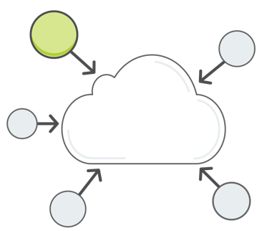
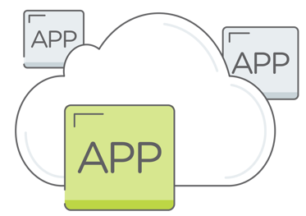

Customer Testimonial
Global healthcare company; AWS savvy and presence in 90+ countries
Objective:
DC consolidation and migration to AWS.
Simplified operations while moving workloads to cloud.
Ease of moving apps/workloads back to on-premises as needed.
Results:
Cluster orchestration within minutes with simplicity to leverage existing AWS networking setup.
One-click management and operations via Prism.
App mobility with zero application change.
DC Consolidation
Cloud Migration
"We had positive experience with the product and did not see any issues during early access once security ports were opened"

Slide 28
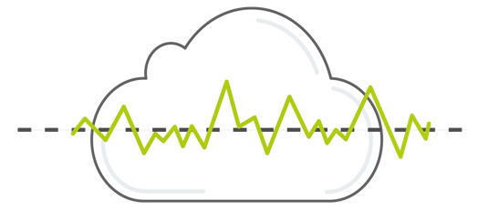
Customer Testimonial 2
Large Healthcare org in Eastern US Early in cloud adoption and using temporary workloads for researchers
Objective:
Launch Clusters on AWS on-demand for Citrix desktops.
Seamlessly move to on-premises after nodes are procured.
Need workaround for capital costs, lengthy procurement cycles.
Results:
Cluster creation within minutes with simplicity to leverage existing AWS networking setup.
Successful movement and start of instances on premises.
On-Demand capacity for Citrix VDI
“The experience was smoother than we expected, we will showcase the ease of use of Nutanix Clusters on AWS to other team members.”

Slide 29
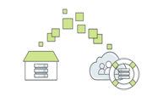
Fred Hutchinson Cancer Research Center
US medical research organization; early in cloud adoption journey.
Objective:
Hybrid cloud architecture that spans private and public infrastructure.
Spin-up Clusters on AWS for burst capacity and DC failures.
Use AWS as tertiary DR for regional failures.
Results:
Simplicity to leverage existing Nutanix/AWS accounts
Single management plane for on-prem and cloud deployments.
Native integration enables seamless VM/app migration without retooling
On-Demand capacity
Disaster Recovery
"Team has done remarkable job of packaging complex functionality in this product. Nutanix Clusters seems well thought-out and we are interested in close collaboration with Nutanix to build a cloud agnostic solution"

