Slide 1




2HFY20 APJC
Cisco Designed
Promotions and Offers

Slide 2

Build small business resiliency with Cisco products
Meraki
Webex
Any
Connect
DUO
Umbrella
On-prem
NGFW
On-prem
switching
On-prem VPN
Routing
AMP4EP
Notes:
z

Slide 3
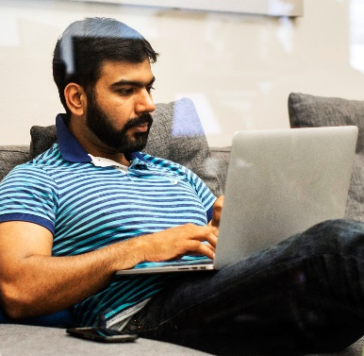
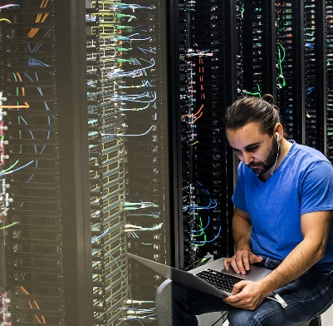
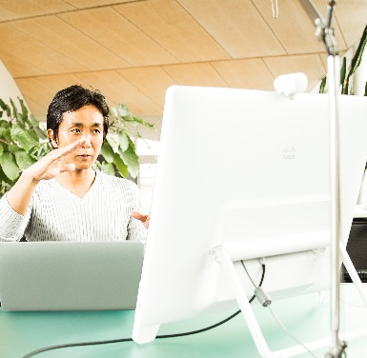
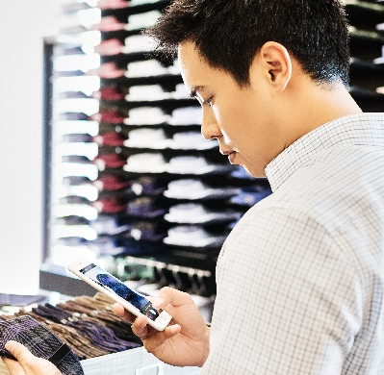
APJC Cisco Designed exciting offers are here
-Support SMB build resilience
SMB Business Operations Impact (use cases)
Shift to virtual,
Telework: staff must
work from home
Heightened security risk because of telework
Telemedicine deployment at GPs and clinics
E-learning deployment at K12 & tuition centers
SMB relocation, temporary facilities network set up; restaurants, shops change to e-delivery/
POS system set up
Click here
Click here
Click here
Click here
Maintain business
Grow business
How Cisco help you stay in business
How Cisco help you generate revenue for business
Stay connected from home
Generate revenue for your business

Slide 4






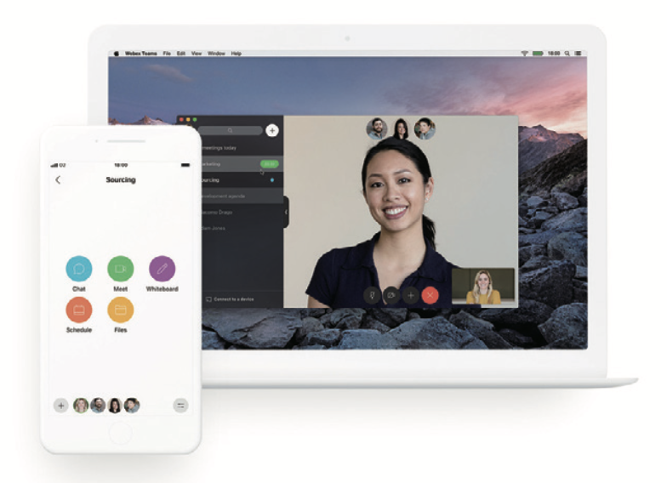
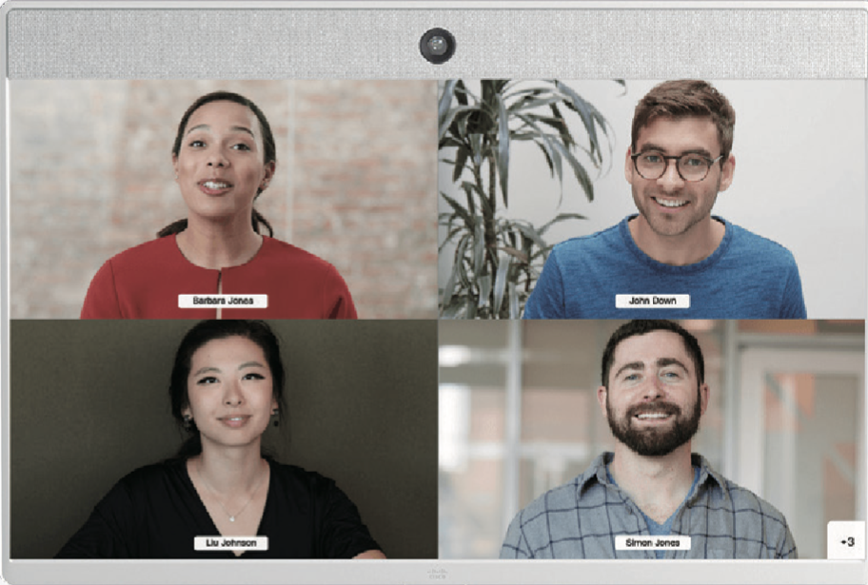


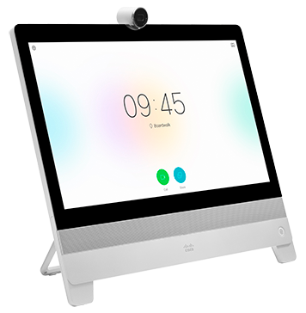
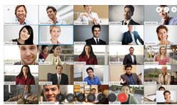


How Cisco help SMB stay in business
-Security is NEVER a tradeoff for convenience or speed
Shift to virtual: Teleworking
Remote Access VPN
VPN
Umbrella - DNS Security
(starting from one user)
Firepower 1K
VPN Router
AnyConnect
DUO – MFA
(ANZ, SG, JP)
208.67.222.222
or
Cloud Delivered/SaaS
MX Small Branch
Z3 teleworker Solution
DUO – MFA
(ANZ, SG, JP)
Umbrella - DNS Security
(starting from one user)
208.67.222.222
Webex for Collaboration
Webex Meetings
Webex Teams
Video Endpoints
With Cloud Registration
Webex Room USB
Webex Room Kit Mini
DX80
Webex board/Webex Telepresence

Slide 5
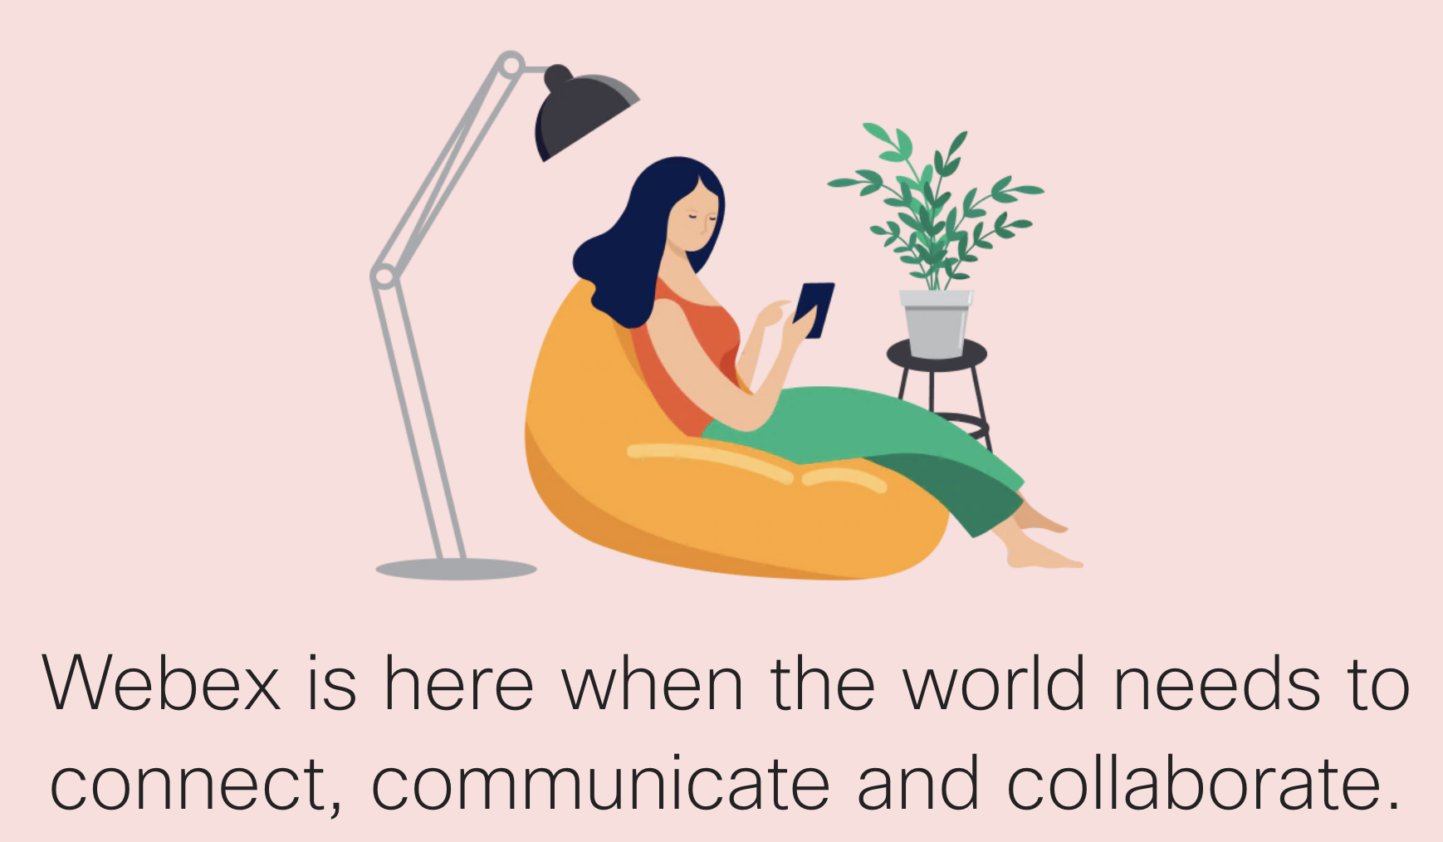
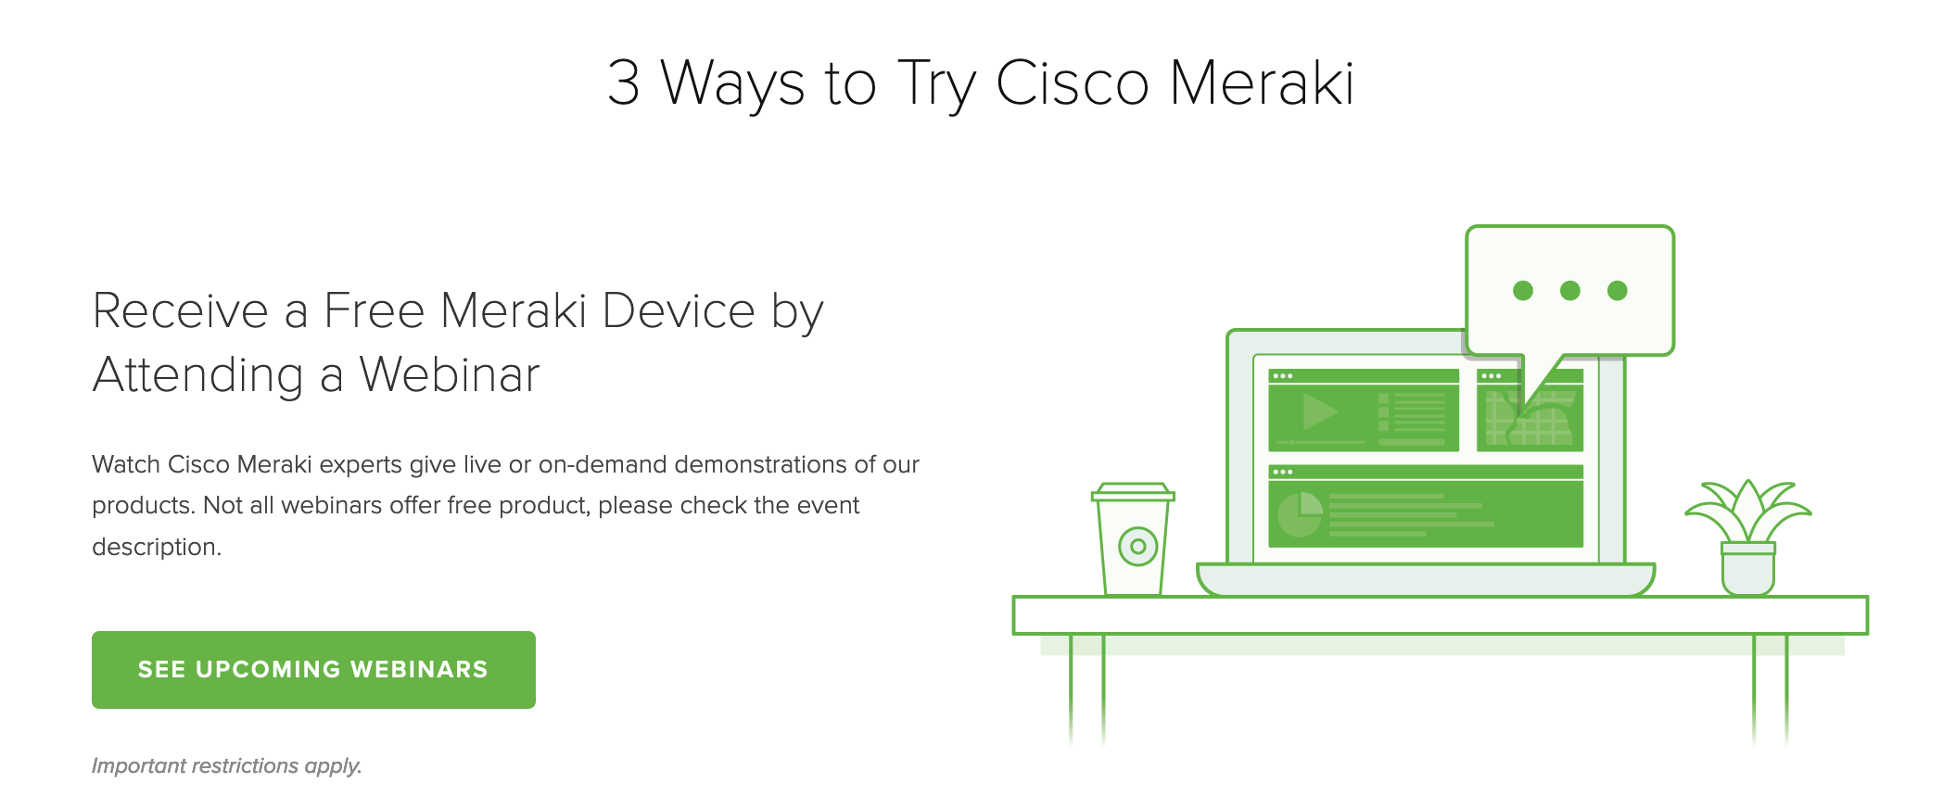
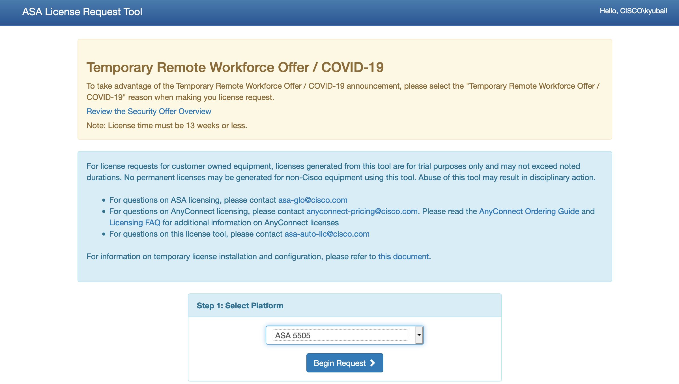
Key offers to highlight under Teleworking
Shift to virtual: Teleworking
List of freemium offers
List of buying offers
Meraki Free Trail https://meraki.cisco.com/lp/free-demo
Webex.com freemium offers for teleworking https://www.webex.com/
Anyconnect: Free 90-day Anyconnect trial: asa-license.cisco.com
MX & Z3 & MI in the high 60s via Meraki remote office BR promotion
FPR1K (FTD image or ASA image ) in the high 60s or even higher via Fast Track
VPN Router RV series & ISR1K in the high 70s via Fast Track
Webex meeting lic in the high 60s via Flex Plan Named User Meeting Promo for SMB
Collaboration video end points in the high 70s via Fast Track that includes board 55, DX80, Room Kit, Room Kit mini, webex USB as well as IP Phones & Headsets

Slide 6



How Cisco help SMB stay in business
-A Security-First approach to remote working
Securely connecting
to public/hybrid Cloud
Manage heightened security risk
Office 365
Google Cloud
SAP
Salesforce
Dropbox
Amazon Web Services
3
Prevent your data from malware, ransomware
and so much more..
2
Secure your network
1
Protect your password
Umbrella - DNS Security
(starting from one user)
VPN
Firepower 1K
VPN Router RV&ISR1K
208.67.222.222
DUO – MFA
(ANZ, SG, JP)
AnyConnect
AMP for Endpoints
MX cloud managed security
Multi-Factor Authentication
Network Security
Cloud Security
Endpoint Security
Supported by TALOS

Slide 7
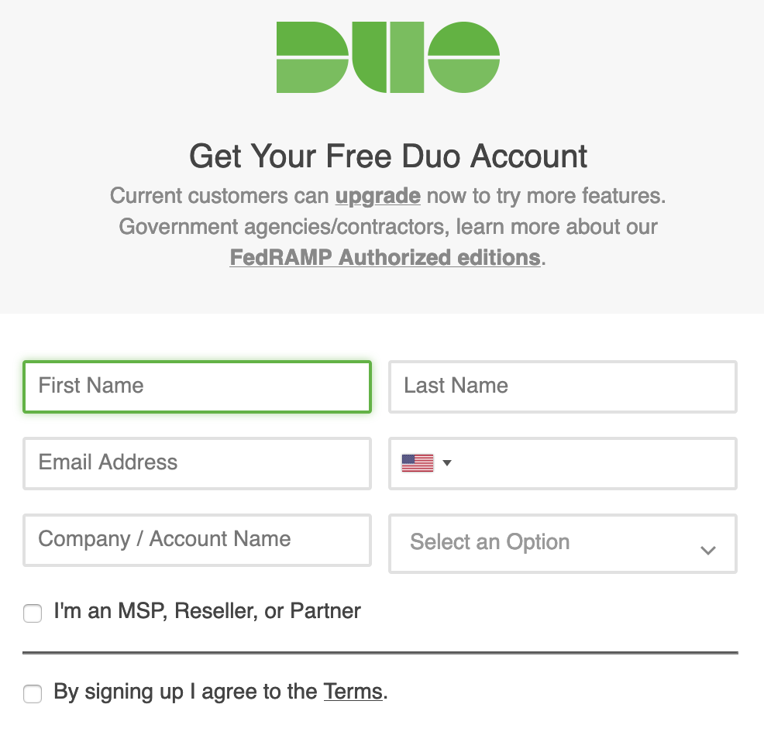
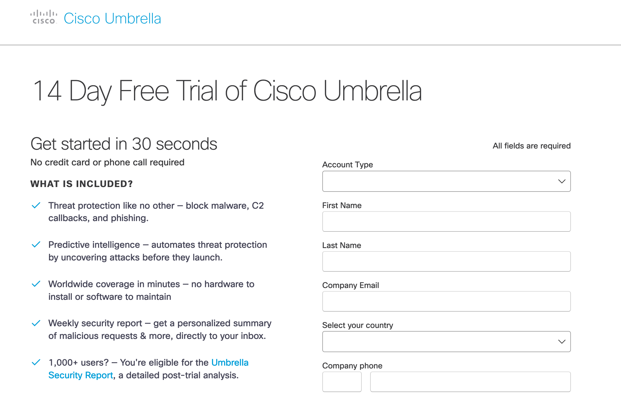
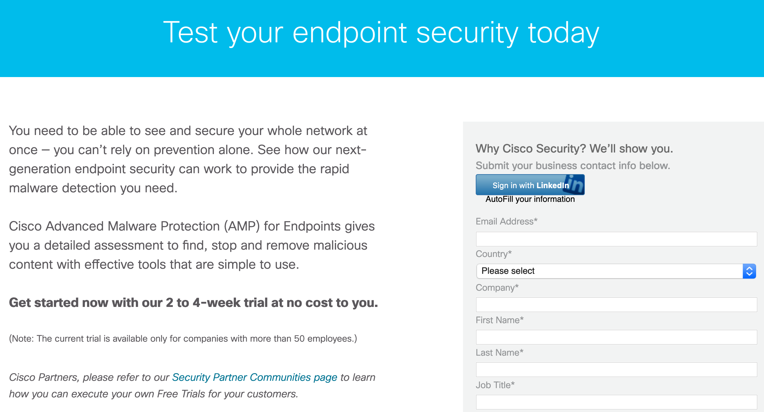
Key offers to highlight under managing heightened security risk
Manage heightened security risk
List of freemium offers
List of buying offers
DUO: Request 30-day trial via
signup.duo.com (ANZ, SG & JP)
Umbrella: Extend free trial period of
Umbrella from 14 to 90 days https://umbrella.cisco.com/
AMP for Endpoint free trail: https://engage2demand.cisco.com/LP=4691
MX & Z3 & MI in the high 60s via Meraki remote office BR promotion
FPR1K (FTD image or ASA image ) in the high 60s, or even higher via
Fast Track accelerator in Q3
DUO in the range of the 30s, UMB, AnyConnect and AMP4EP in the range of the 60s via Cisco security scale play for SMB scale plus promotion when MX or FPR1K purchased together

Slide 8

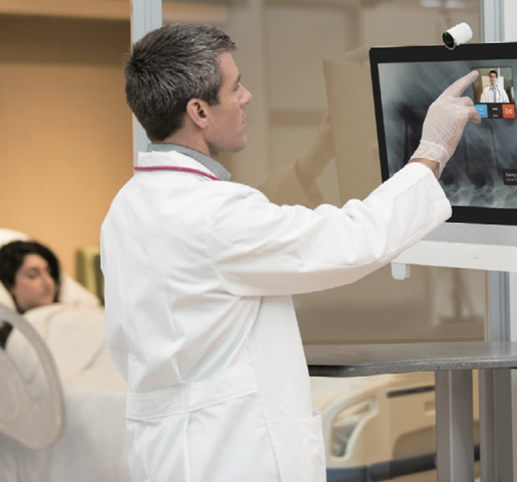
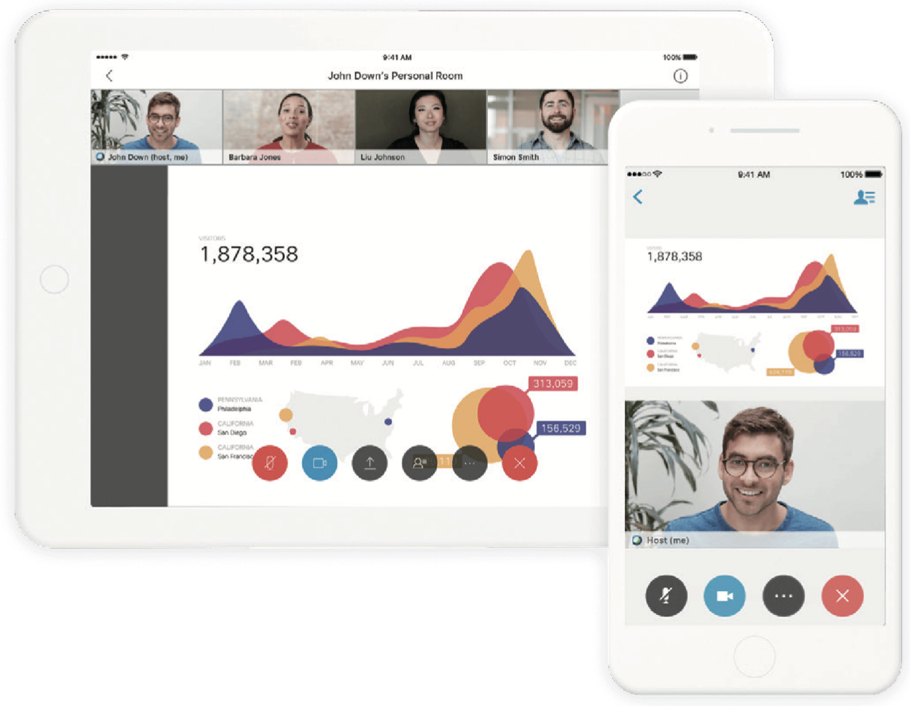
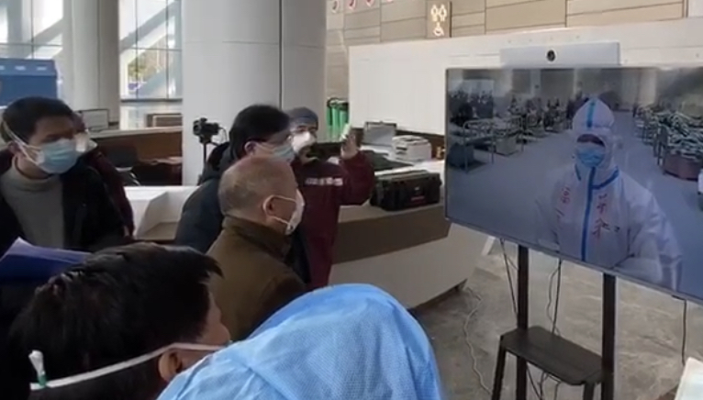
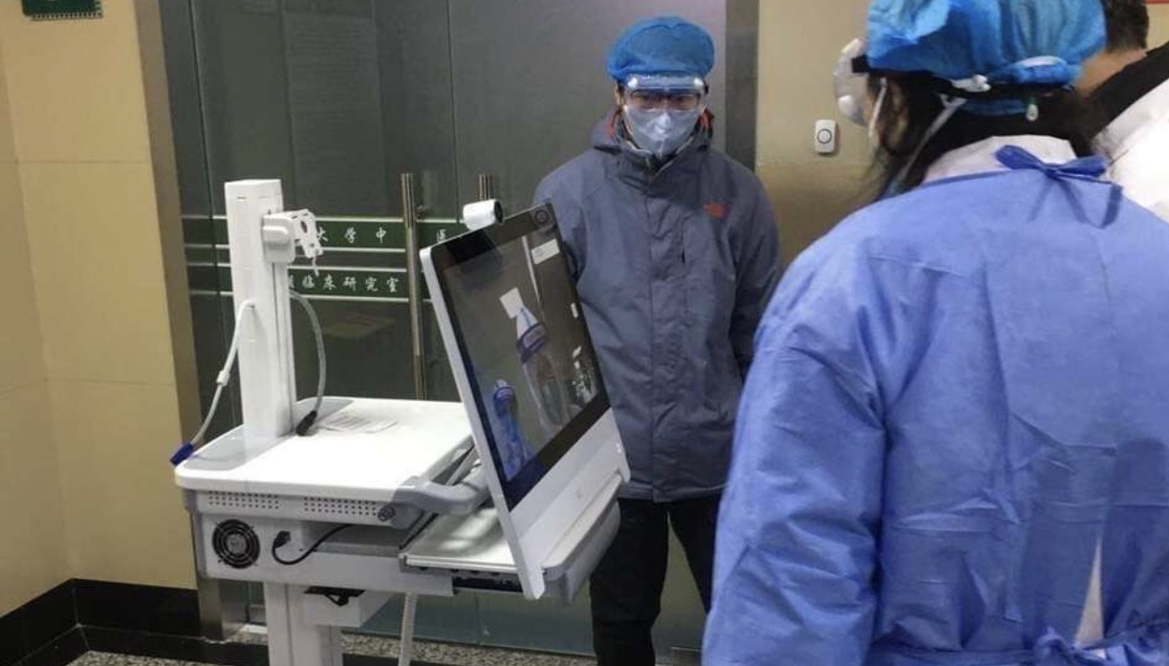
How Cisco help SMB grow the business
-Collaboration without compromise
Connected via Webex
Telemedicine/E-learning
Webex for Telemedicine,
Connecting and Saving lives
Webex for E-learning, Connecting and Learn safely
Webex
Meetings
Video Endpoints
With Cloud Registration
Webex
Meetings
Video Endpoints
With Cloud Registration
Webex Room USB
Webex Room Kit Mini
DX80
Webex Room USB
Webex Room Kit Mini
Who are you? Click a button to get the best resources for you:
School
Teacher
School
Student
School
Parent
Higher Ed
Faculty
Higher Ed
Student
Education IT Admin
Webex Room Kit
DX80

Slide 9
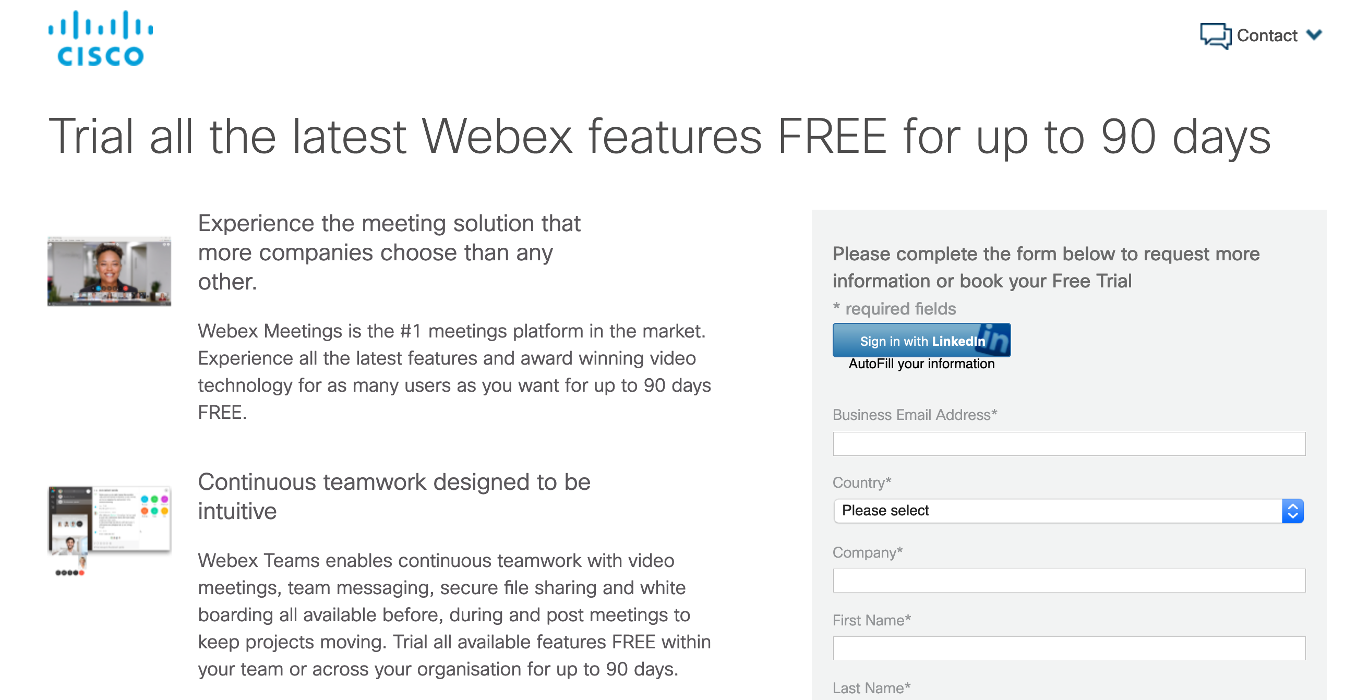
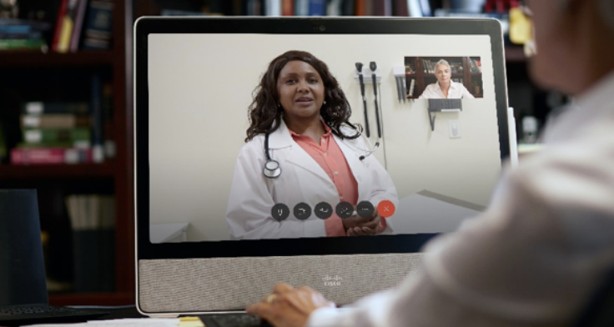
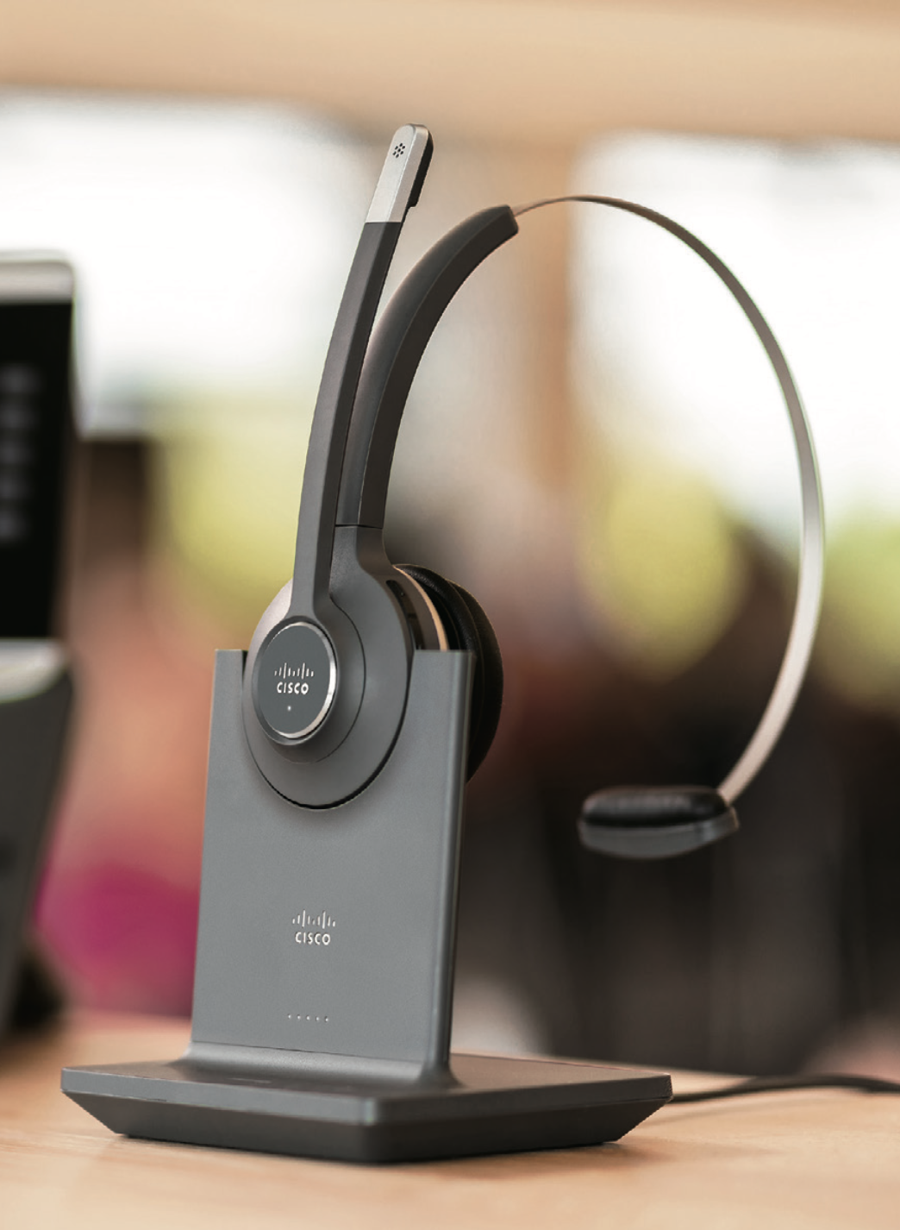
Key offers to highlight under connected with Webex
Connected with Webex
Telemedicine/E-learning
List of freemium offers
List of buying offers
Sign up for your free webex meetings plan https://www.webex.com/pricing/index.html
90 days full features free trail, provision via CCEP (Cisco) or CUWP (Partners) https://engage2demand.cisco.com/LP=13958?ccid=cc001228&oid=trlco020634
Free trainings on demand: How to use webex for Telemedicine https://www.webex.com/webexremotehealth.html
Free training on demand: How to use webex for E-Learing https://www.webex.com/webexremoteedu.html
Webex meeting lic in the high 60s via Flex Plan Named User Meeting Promo for SMB
Collaboration video end points in the high 70s via Fast Track that includes board 55, DX80, Room Kit, Room Kit mini, Webex USB as well as IP Phones and Headsets

Slide 10
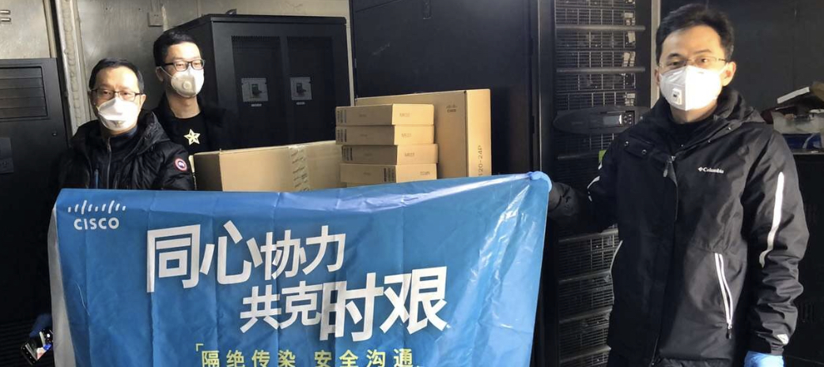
How Cisco help SMB grow the business
-Only Cisco network protects your data from end to end
Network set-up for relocation, temporary facilities, shops online
Temporary WIFI network
set up
Set up
network connectivity
MR36: first wifi 6 cloud
managed access point
MS120/210/225 series
cloud managed switching
Or
Or
Temporary WIFI network
set up
Set up
network connectivity
Set up
network connectivity
Aironet 1840 series
Most cost effective access point
Catalyst 1000 series
compact, fanless with PoE+
Catalyst 9200L series Scalability, programmable and resilient
The network is many SMB business’s lifeline

Slide 11
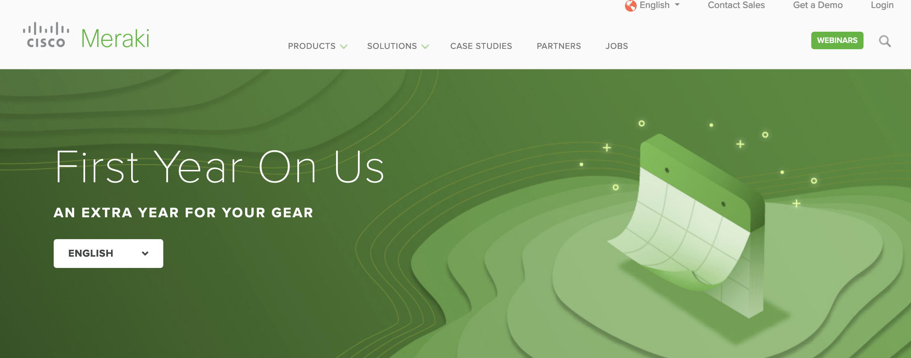
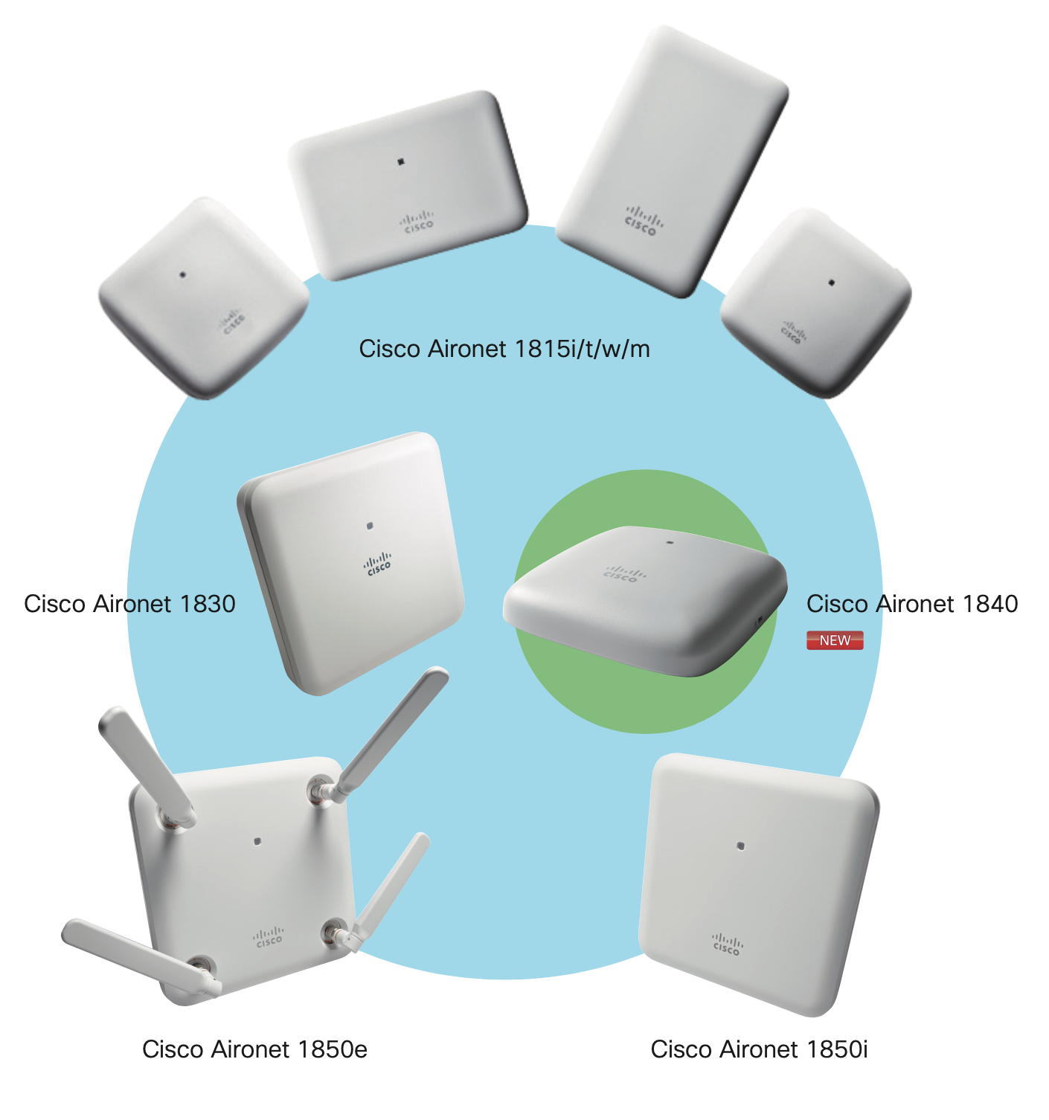
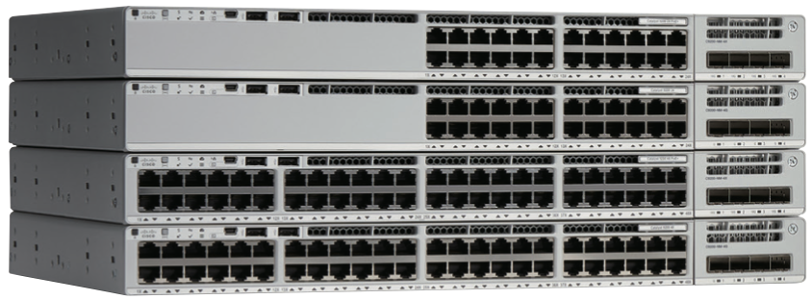
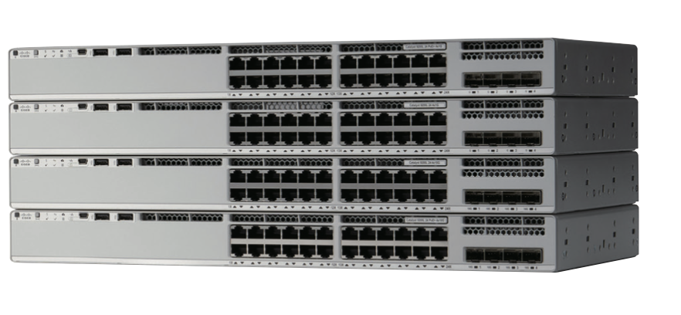
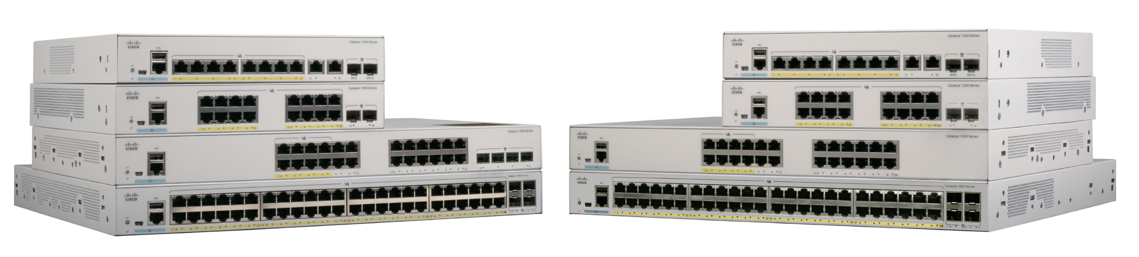
Key offers to highlight under set up network connectivity
Network set-up for relocation, temporary facilities, shops online
List of freemium offers
List of buying offers
Meraki Free Trail https://meraki.cisco.com/lp/
free-demo
The first year on us for Meraki MR 36 & MS120/210/225 series
WiFi wave 2 AP1840 Buy 1 get 1 free ( including 1815I, 1840I
and 1852I&E)
Cat1K POE switch (16FP and 24FP) for small only : Buy 2 get 1 free in ASEAN, KR, HK; buy 3 get 1 free in India
Cat9K DNA-E license for small only: Pay 2 for 3 in ASEAN, ANZ, INDIA, KR, HK and TW, pay 4 for 5 for India
Cost Effective Wave 2 Aironet
access point 1840: Buy 1 get 1 free
Catalyst 9200L series software license:
Pay 2 for 3, pay 4 for 5 for customers in SMALL
Catalyst 1000 series full POE,
buy 2 get 1 free promotion for small
Software package | Product SKU
 | 3-Years | 5-Years
Cisco DNA Essentials | C9200L-DNA-E-24-3Y | C9200L-DNA-E-24-5Y
 | C9200L-DNA-E-48-3Y | C9200L-DNA-E-48-5Y

Slide 12





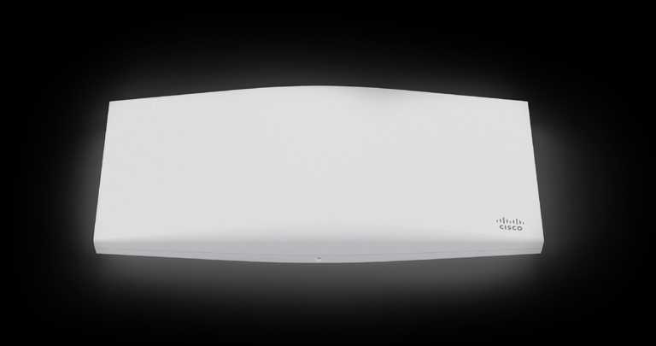
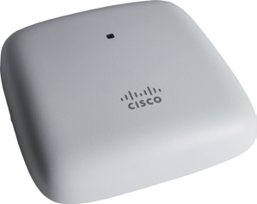
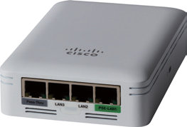
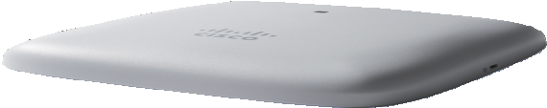



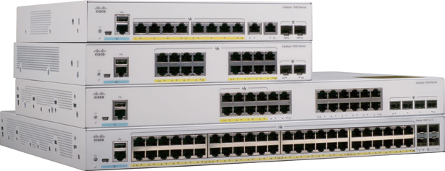
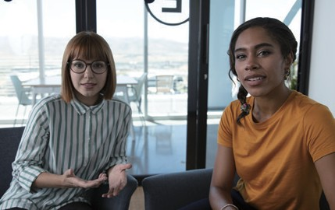








What’s New in 2HFY20
Cisco Products & Solutions for SMB
Supporting business continuity during the COVID-19 pandemic www.cisco.com/c/m/en_us/covid19.html
Cisco offers a wide range of new products and networking solutions designed for small and medium-sized businesses across a variety of industries.
Wireless Access Points & Mesh Extenders
Cisco Business 100/200 Series access points
Wireless Access Point
Cisco Aironet 1840 Series
Cloud Managed Wireless Access Point
Cisco Meraki MR36
LAN Access Switches
Cisco Catalyst 1000 Series
LAN Access Switches
Cisco Catalyst 9200/L Series
Collaboration EndpointsLAN Access Switches
Cisco Webex Room USB
Next-Generation Firewalls
Cisco Firepower 1000 Series
Cloud Security
Cisco Umbrella New Packages
Umbrella
Multi-Factor Authentication
Cisco Duo Security
Is that you?
user@email.com
SIGN IN
© 2020 Cisco and/or its affiliates. All rights reserved.

